Slide 1

Department of Computer Science and Engineering
Project Identification Phase
PROJECT TITLE
Elevating Democracy: Blockchain-Secured Voting with Enhanced Identity Authentication
VISVESVARAYA TECHNOLOGICAL UNIVERSITY - BELAGAVI
Accredited by NBA
Students Name:
Mr.Narayan G Patil (2BU20CS035)
Ms.Shreya Karalgekar(2BU20CS107)
Mr.Deepak Bhadgaonkar (2BU21CS405)
Ms.Gouri Rane(2BU21CS406)
Guide Name:
Name: Ms. Rajeshwari Kisan.
Designation: Professor

Slide 2
Content
Introduction
Literature Review
Gaps Identified
System Requirement Specification
Problem Statement
Objectives
Proposed Methodology
Expected Results
References

Slide 3
Introduction
Electronic voting (e-voting) systems are pivotal in modernizing the electoral process, offering convenience and accessibility to voters.
This study explores the implementation of an innovative e-voting system using blockchain technology, a decentralized and tamper-proof digital ledger.
In this study, we present a comprehensive analysis of existing e-voting challenges, including security vulnerabilities, privacy concerns, and lack of transparency.
The proposed system ensures secure voter registration, anonymous vote casting, and transparent tallying of votes.

Slide 4
Literature Review
S.No | AUTHOR | TITLE | METHODOLOGY | LIMITATIONS
1 | Kamil, M.; Bist, A.S.; Rahardja, U.; Santoso, N.P.L.; Iqbal, M | “COVID-19: Implementation e-voting Blockchain Concept” | Tackles election during COVID-19, brings effectiveness and efficiency | Authentication, refining the process of Blockchain for e-voting
2 | Roopak, T.; Sumathi, R. | “Electronic voting based on virtual id of aadhar using Blockchain technology” | Voters register with Aadhaar, authenticate with biometrics, and cast encrypted votes on a secure blockchain ledger. This offers transparency, security, and efficiency, but challenges remain. | Generating and analysing fingerprints is hard
3 | Khan, K.M.; Arshad, J.; Khan, M.M. | “Investigating performance constraints for blockchain based secure e-voting system” | analyzes the system's performance under varying volumes of transactions and remote clients, studying how these factors impact overall performance. | It does not explicitly state security aspects such as uniqueness and ballot reception

Slide 5
4 | Hanifatunnisa, R.; Rahardjo, B. | “Blockchain based e-voting recording system design” | Security, transparency, and reduced cheating sources of database manipulation | Lack of personal voter authentication
5 | Uzma Jafar *Mohd Juzaiddin Ab Aziz andZarina Shukur | “Blockchain for Electronic Voting System—Review and Open Research Challenges” | Blockchain shows promise in overcoming electronic voting challenges, but research is needed to address scalability, privacy, security, and regulatory hurdles. | Usage authentication not stated
6 | Neelam Keerthi, Annam Raghuram, Ramesh Jayaraman | “Interfacing of Online and Offline Voting System with an E-Voting Website.” | The study integrates online and offline voting systems with an e-voting website. Online voters register and vote through the website and vote on a web-based interface. | Security Concerns Voter Authentication Infrastructure and Resources
7 | Ayed, A.B | “A conceptual secure Blockchain-based electronic voting system” | Secure, reliable, anonymous voting might improve local or national elections | Lack of authentication and privacy for users
7/12/2023

Slide 6
Gaps Identified
Lack of security and consensus protocol.
Expensive and time-consuming.
Lack of authentication and privacy for users.
Transparency Issues.
Absence of Cutting-Edge Technologies.
Tampering Vulnerabilities.

Slide 7
System Requirement Specification
Software Requirements:
Programming Language for smart contract: Solidity
Development IDE: VisualStudio Code, Ganache
Database: MySQL
Frontend: React JS, TypeScript, SCSS, Antd
Backend: Express JS, Truffle

Slide 8
Hardware Requirements:
Processor: Intel Core i5 10th Gen
Speed: 1.6 Ghz (minimum)
RAM: 4 Gigabyte (minimum)
Memory: 200 Megabyte (minimum)

Slide 9
Problem Statement
Current electronic voting systems are vulnerable to tampering and lack strong authentication measures, posing risks to the integrity of electoral processes. This project seeks to enhance security and transparency by integrating blockchain technology and face recognition into the existing e-voting infrastructure. The goal is to mitigate manipulation and unauthorized access, ensuring the trustworthiness of electronic voting in democratic processes.

Slide 10
Objectives
Strengthen the e-voting system against unauthorized access and manipulation.
Improve the speed of vote tallying.
enhance the system's ability to handle a large volume of votes, ensuring efficiency during peak periods.
Create standardized protocols for secure electronic voting, ensuring consistency and reliability across different jurisdictions.
Decrease operational expenses associated with traditional voting methods.

Slide 11
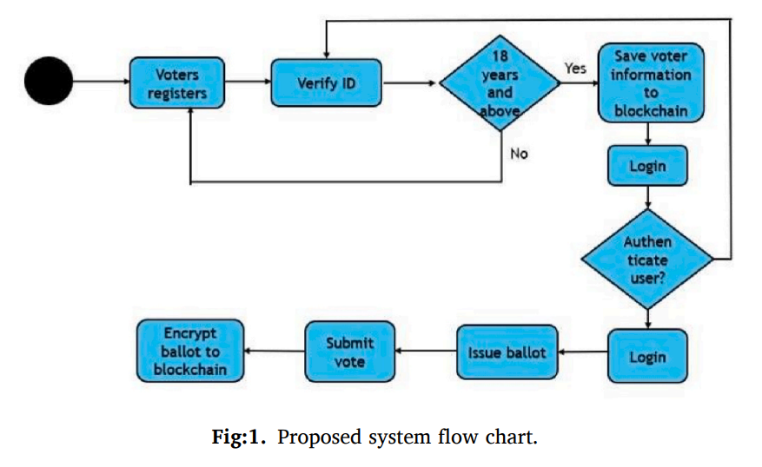
Proposed Methodology

Slide 12
Expected Results
1. Security: Blockchain technology provides a decentralized and tamper-resistant ledger, making it difficult for malicious actors to manipulate or alter voting records. This enhances the overall security and integrity of the voting system.
2. Transparency: Blockchain's transparency features allow all participants to view and verify the transactions on the network. This transparency can contribute to increased trust in the electoral process.
3. Decentralization: The decentralized nature of blockchain reduces the risk of a single point of failure or manipulation. This makes it harder for external entities to compromise the entire system.
4. Accessibility: Blockchain-based voting systems can potentially offer increased accessibility, allowing eligible voters to cast their votes remotely without compromising security.

Slide 13
References
S.No | AUTHOR | YEAR | TITLE
1 | M. S. Farooq, M. Khan, and A. Abid | 2020 | “‘‘A framework to make charity collection transparent and auditable using blockchain technology”.
2 | D. Chaum, A. Essex, R. Carback, J. Clark, S. Popoveniuc, A. Sherman, and P. Vora | 2021 | “E-voting 40 scantegrity: End-to-end voterverifiable optical-scan voting”.
3 | J. Huang, D. He, M. S. Obaidat, P. Vijayakumar, M. Luo, and K.-K.-R. Choo | 2022 | “The application of the blockchain technology in voting systems: A review”.
4 | T. Dimitriou | 2020 | “Efficient, coercion-free and universally verifiable blockchain-based voting”.
5 | A. Barnes, C. Brake, and T. Perry | 2022 | “Digital Voting with the use of Blockchain Technology Team Plymouth Pioneers-Plymouth University”.
6 | Kriti Patidar, Swapnil | 2019 | "Decentralized E-Voting Portal Using Blockchain”.

